Slide 1

Teamwork
Megan Davies,
Deputy Head of Careers and Employability

Slide 2
Aims of today’s workshop
Recognise what makes a good team
Be aware of the different roles within a team
Understand the importance of team skills
Understand your own strengths working in a team

Slide 3

Frustrations of working with people

Slide 4
Why are we covering this?
Group Projects as part of your course
A result of student feedback
Teamwork is one of the fundamental skills employers look for and it's on the graduate recruiters' high priority list.
Most people have to work in multi-disciplinary teams e.g. designers, UX, sales, business owners, leaders, clients

Slide 5
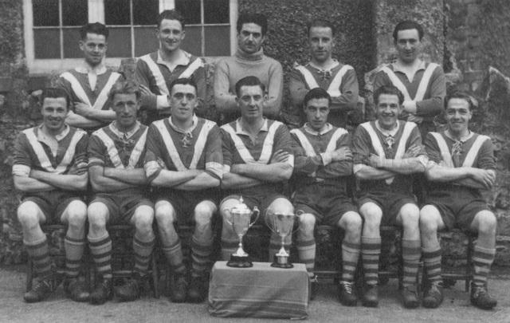
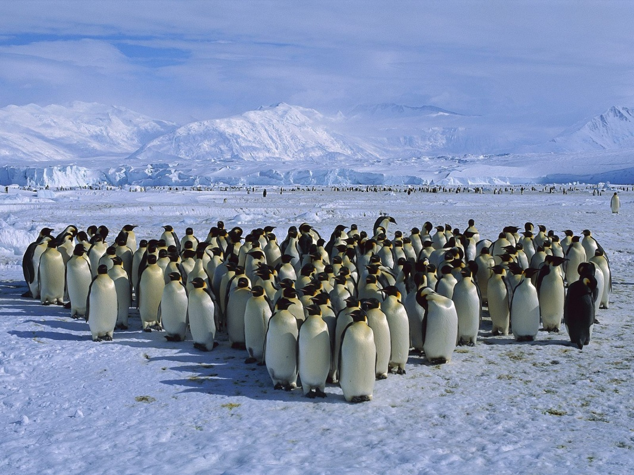
Differences between a team & a group?

Slide 6
What is the difference between a team and a group?
Teams grow and develop, progressing through a series of stages to reach MATURITY
STAGES relate to new teams or those which are reformed when individuals move in or out

Slide 7
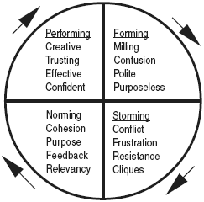
Team Development Wheel
Notes:
In Theory - Tuckman's stages of group development(Bruce!)

Slide 8
FORMING:
Emphasis is on:
getting acquainted
forming relationships
understanding tasks
setting goals and objectives
Looking to the leader for guidance

Slide 9
STORMING:
Involves conflict:
competing for position of power
challenging leaders authority
disagreeing over work methods, allocation of responsibilities
questioning the value and feasibility of task
If not resolved leads to poor performance

Slide 10
NORMING:
Harmony, sense of identity:
communicating openly
sharing information, ideas, feelings
listening to each others’ views
supporting
establishing team norms for acceptable behaviour
Leads to cohesion and unity

Slide 11
PERFORMING:
Working well
collaborating closely
participating fully
surging ahead on tasks
achieving more than the sum of the individual

Slide 12
Performing teams characterised by
Tasks well defined
Great commitment to team goals
High team morale
Team highly focused and person oriented
Intense mutual respect and group loyalty
A new member will cause team to regress to earlier stage

Slide 13
MOURNING:
Loss of an individual or disbanding of team
don’t neglect - it’s a vital stage
encourage celebration of achievement
need to come to terms with change and move on
If neglected leads to
inability to look forward positively
hankering after the ‘good old days’

Slide 14
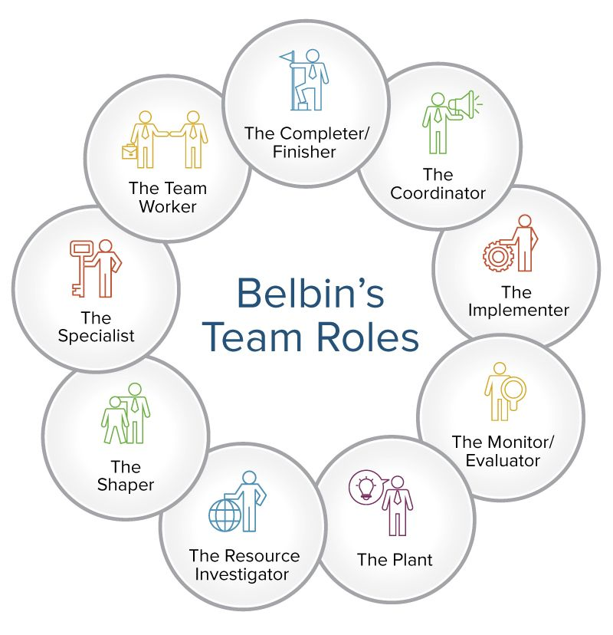
Belbin

Slide 15
Belbin Team Roles
What is a Team Role?
“A tendency to behave, contribute and inter-relate with others in a particular way.”
Belbin may help you to
Understand your own identity in terms of team roles
Manage your own strengths and weaknesses
Learn how to develop your own team roles
Project yourself in the best possible way
Work more effectively in teams

Slide 16
Belbin
Search for ‘magic ingredient’ which make winning teams
Self Perception Inventory
Nine different team roles
Success lies in balanced teams

Slide 17
Completing the form
5
3
2
You have 10 points to distribute in each section
Points can be distributed among no more than 4 sentences
You can give all 10 points to a single sentence
Each section must add up to 10

Slide 18
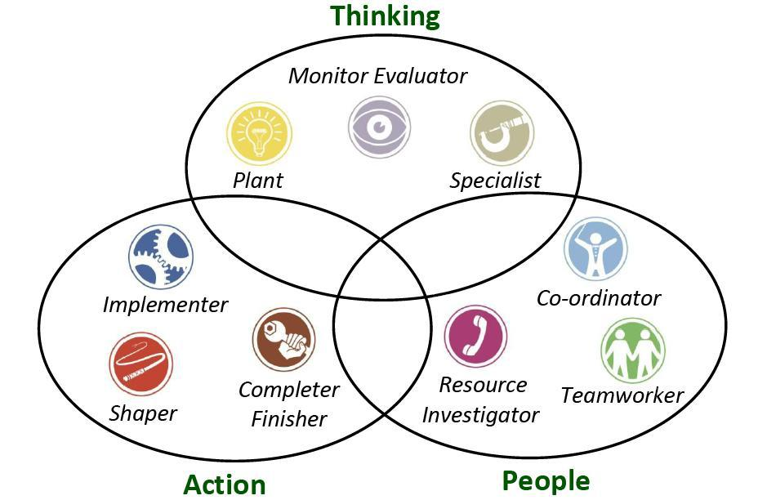
Belbin’s Clusters

Slide 19
Bibliography
Belbin, M R, Management Teams. Why they Succeed or Fail, Oxford et al: Butterworth/Heinemann, 1981.
Belbin, M R, Team Roles at Work, Oxford et al: Butterworth/Heinemann, 1993.

Slide 20

Employers and Recruitment
Be aware of what employers say they are looking for:
Good team players
good communicators
people who can hit the ground running

Slide 21
Employers and Recruitment
Be aware of what they are actually looking for:
People who will ‘fit in’ to their organisation.
Feel at home with others already working for them.

Slide 22
Employers & Recruitment
Effective teamworking is essential for the success of an organisation
Job description
Application Form
Interview
Assessment Centre

Slide 23
Employers & Recruitment: questions at application and interviews
Experience of working in a team?
What role did you play?
How did you influence the situation? How did you persuade the other team members of your point of view?
How did you make sure the team was successful in achieving its goal?
Describe a situation where you worked as part of a team. What did you personally contribute?
Specific examples
A range of examples
Your role
Outcomes
Lessons learned

Slide 24
Employers & Recruitment: Assessment Centres
Group/Team Exercises:
Open discussions on given topics
Work related exercise with specific goals
Case studies
Role play
Questioned/presentation - individually or as a group
Employers are looking for evidence of:
participation and contribution
analysis, presentation of an argument
communication
listening abilities
negotiation and co-operation
dealing with conflict

Slide 25
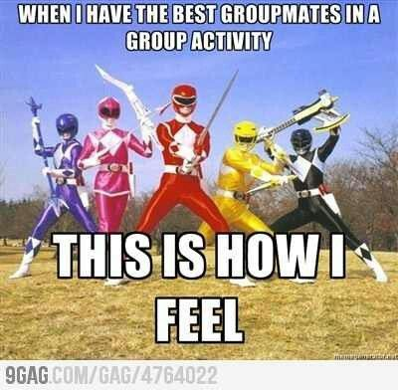
Today’s Aims
Recognise what makes a good team
Be aware of the different roles within a team
Understand the importance of team skills
Understand your own strengths working in a team

Slide 26

Personality Types Tomorrow 12-2pm, LTA6
What are your preferences?
What are other people’s preferences?
How does that impact on your working relationships?
How does your personality impact on your career and development?

Slide 27
Type Dynamics Indicator details
Go to www.profilingforsuccess.com and select ‘Take an Assessment’.
The website will open in a new window. Make a note of the login details you'll need in order to log on to Profiling for Success:
Client code: tflhe
Access code: stirling
Password: ST2010
Scroll down to Type Dynamics Indicator

Slide 28


Slide 29

Feedback

Slide 30
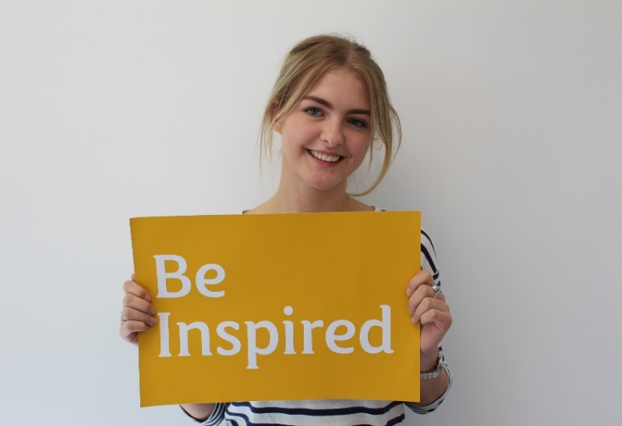
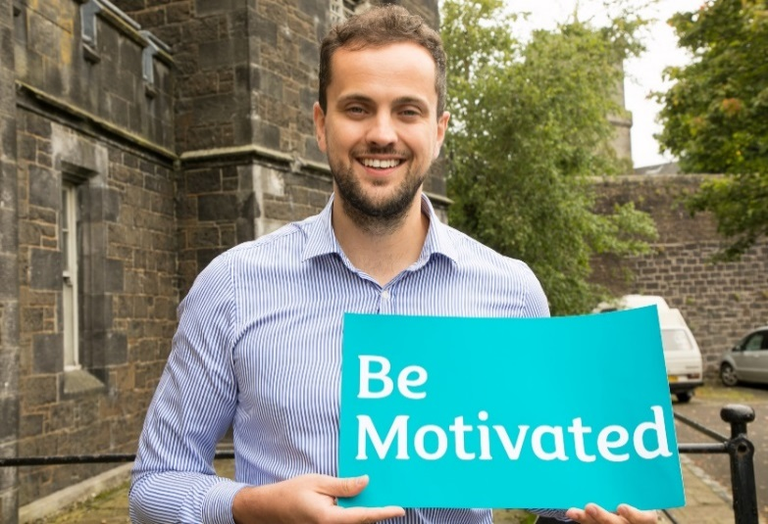
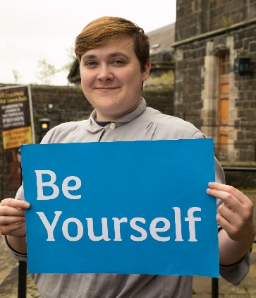
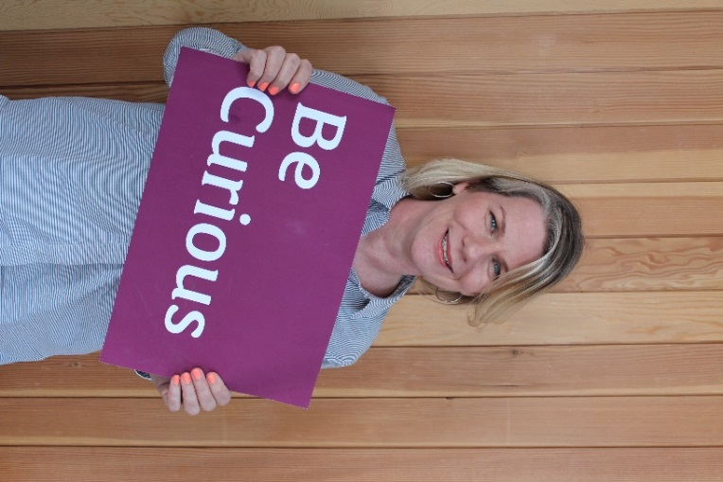
Careers and Employability Service

Slide 31
What’s on this Autumn
Book your place at stirling.targetconnect.net
 | November
1st | Saltire Application session | 4-5pm
5th | Step into teaching | 5-6.30pm
6th | Personal branding | 1-2pm
7th | International student opportunities | 1-2pm
8th | Postgraduate study | 4-5pm

Slide 32

Do you need specific careers advice? Booking a 1-1 appointment may be the support you need. (CV checks, mock interviews, careers guidance, etc.) https://stirling.targetconnect.net/ home.html
One to one Careers Appointments:
Our team of professionally qualified staff are here to offer confidential, one-to-one guidance about any issue relating to careers.
Quick Queries: 15min appointments available Mon- Friday. Book online through Target Connect (https://stirling.targetconnect.net/home.html).
Guidance: 1 hour appointments available, book through the Hub (ask@stir.ac.uk)
Focused Natural Science appointments are run on a Wednesday, but students can book to speak to another Career Consultant at any other time.
FOREVER!

Slide 33

Career Cafes
Wednesdays 12-2pm Underground
Notes:
Wednesdays 12-2pm Underground

Slide 34






Connect with us
stir.ac.uk/careers
StirlingUniCareers
StirlingUniCareers
@StirUniCareers
ask@stir.ac.uk
https://canvas.stir.ac.uk/enroll/P4XBB8

